Slide 1
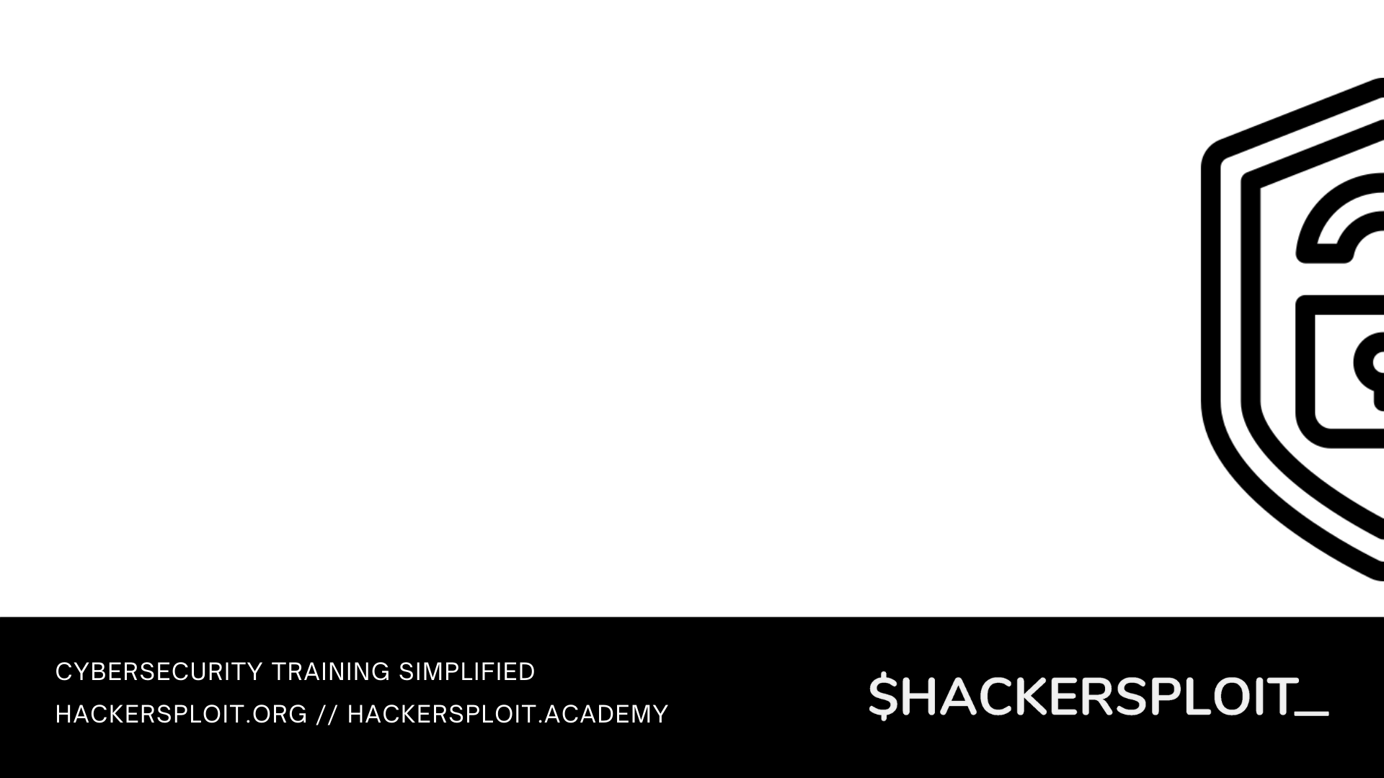

Blue Team Training Series
Introductory guide to blue team operations

Slide 2


Intrusion Detection With Suricata
Network intrusion detection with Suricata

Slide 3

What we will be covering
Introduction to Suricata
Installing & configuring Suricata
Suricata rules
Suricata configuration file
Writing custom Suricata rules
Network intrusion detection with Suricata

Slide 4
Prerequisites
Familiarity with information security concepts.
Familiarity with Linux and various command line utilities.
A good understanding of the OSI model and the layers that make up the model.
Functional knowledge of TCP/IP & UDP.
Familiarity with HTTP & Web technologies.

Slide 5
Introduction to Suricata
Suricata is a free and open-source threat detection engine. It does this by combining IDS, IPS and network security monitoring.
Suricata is owned and developed by the community-run non-profit organization OSIF (Open Information Security Foundation).
GitHub Repo: https://github.com/OISF/suricata
Suricata has 2 main operational modes
Active (IPS) – Used to alert, log and block network traffic that matches specific rules.
Passive (IDS) – Used to identify, alert and log suspicious network traffic within a network.

Slide 6
How Suricata works
Suricata can be deployed as an IDS on a network to monitor network traffic or as an IPS in in-line mode to detect and stop malicious network traffic.
Suricata utilizes a set of predefined rules or rule-sets to identify malicious network traffic.
When malicious network traffic is detected and is matched against a rule or set of rules and alert will be generated and the traffic will be logged.
Similar to Snort, these logs can then be imported or relayed to a SIEM like Splunk for live security event monitoring.

Slide 7
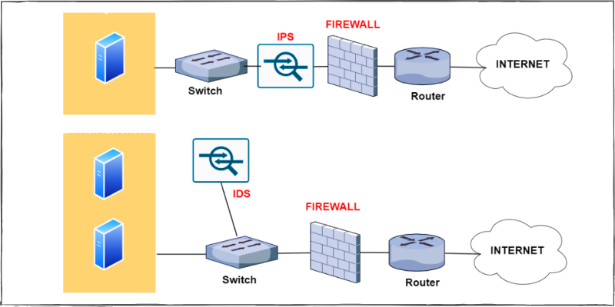
Suricata IDS network placement

Slide 8
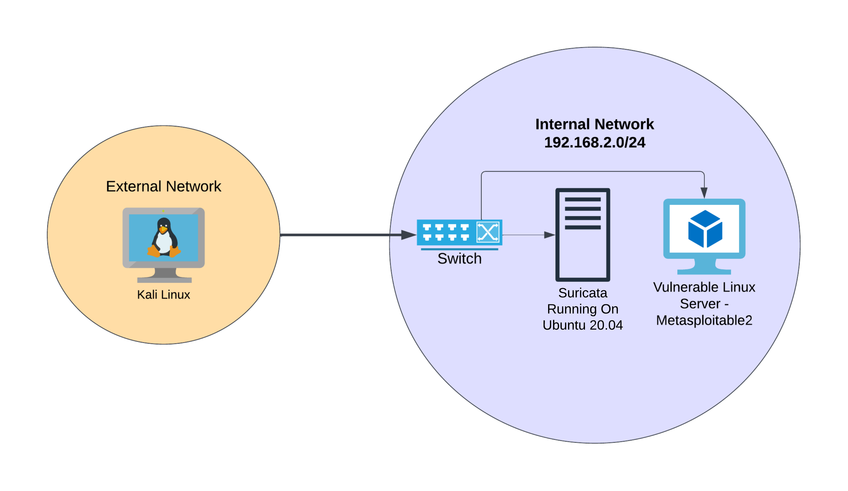
Lab environment

Slide 9
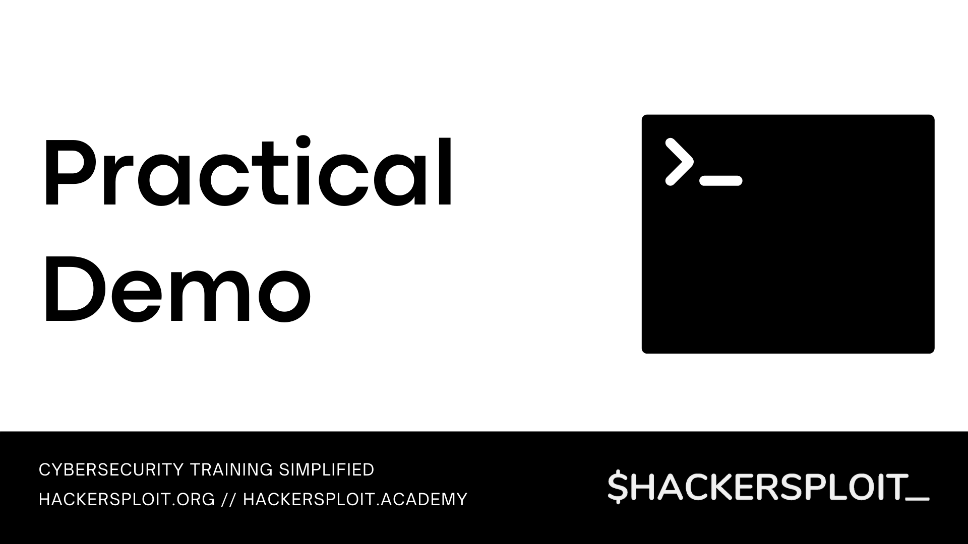

Slide 10


Slide 11
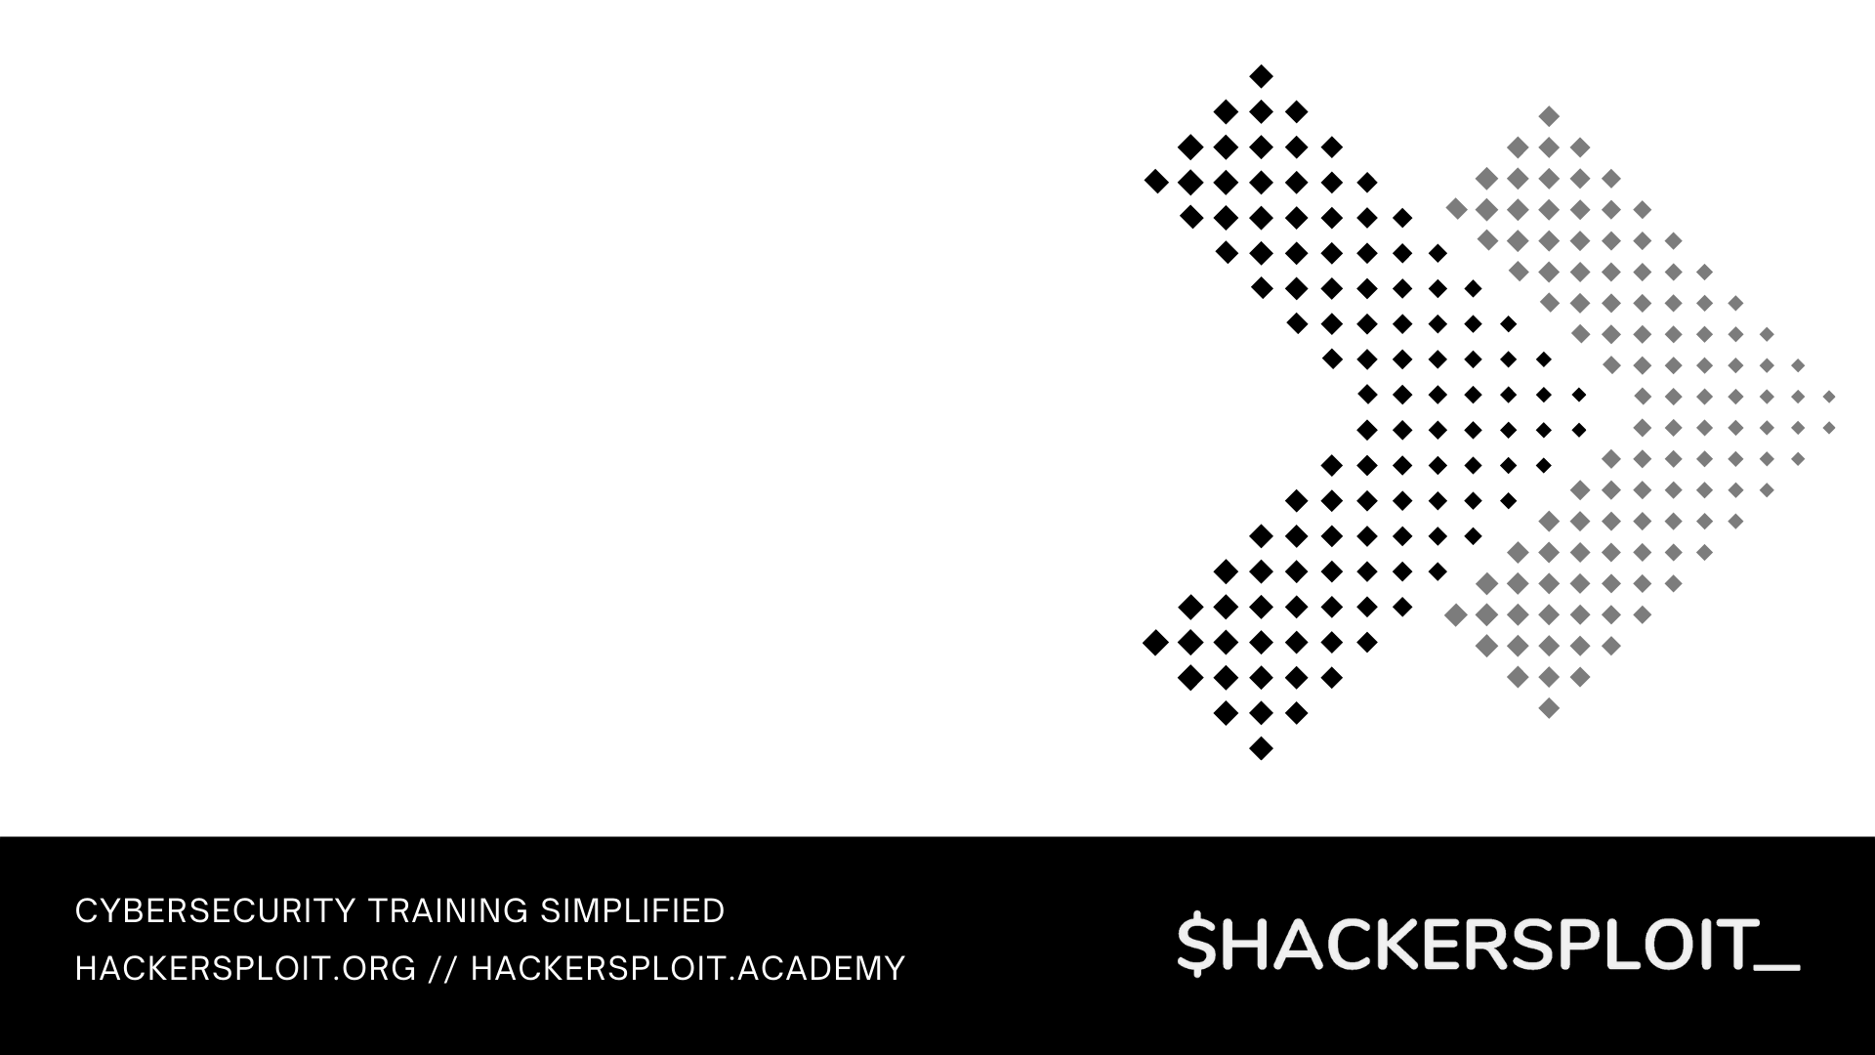

Securing Event Monitoring With Splunk
Next up

